Slide 1
Retrofitting Tests
Tony Baines

Slide 2
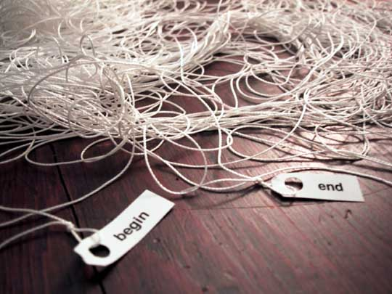
Legacy Code
We don’t always start with a clean sheet of paper.
“Our summer student put this together – can you make these changes …”
Sometimes ‘tactical’ becomes ‘strategic’
“This tool is essential to the platform – fix it!”
We never stop learning.
“It’s about that system you wrote 6 years ago …”

Slide 3
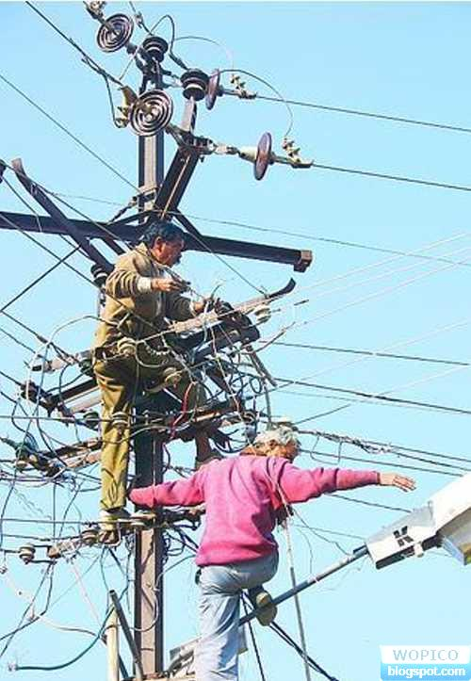
Risky Business
Some jobs are safer than others
How do I make it safer?
Is it worth the cost?

Slide 4

The Cost Of Change
Changing unknown code can be a leap of faith
I want to make it cleaner, but how do I know I won’t break it?
… and I’ll be back again next month
A safety net would be nice

Slide 5
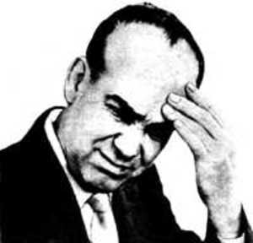
What’s a coder to do?
Buy ‘Working Effectively With Legacy Code’
Michael Feathers - Prentice Hall (7 Oct 2004)
Steps to success
Find the code you need to change
Get it to compile on it’s own (no collaborators)
May need mocks, stubs or language tricks
Guess a behaviour and capture with an assertion
Repeat guess and test for happy and sad paths
Coverage tools can help

Slide 6
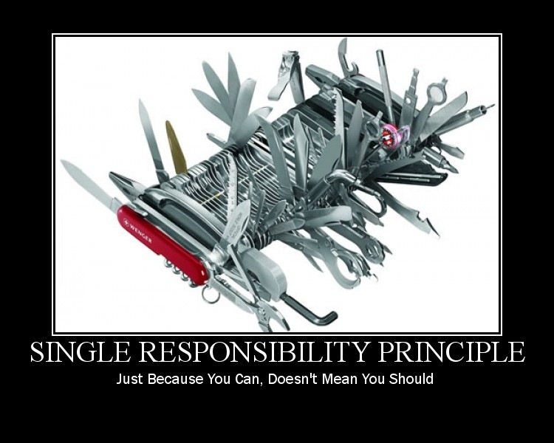
An Example

Slide 7
